Slide 1
Welcome to the
19 August 2022 | Nick Roxburgh

Slide 2
What will be covered…
Introduction to tidyverse
Installing & loading tidyverse
Importing data with readr, readxl, sf, et al.
Tidying data with tidyr
Transforming data with dplyr, purrr, stringr, lubridate
Working with pipes
Visualising data with ggplot

Slide 3
Introduction to tidyverse

Slide 4
Introduction to tidyverse
The goal of tidyverse is to “provide tooling for the most common challenges” that R users encounter, including data import, tidying, manipulation, and visualisation
tidyverse is a collection of R packages that “share a high-level design philosophy and low-level grammar and data structures, so that learning one package makes it easier to learn the next”
Wickham, H., Averick, M., Bryan, J., Chang, W., McGowan, L.D.A., François, R., Grolemund, G., Hayes, A., Henry, L., Hester, J. and Kuhn, M., 2019. Welcome to the Tidyverse. Journal of open source software, 4(43), p.1686.

Slide 5
Introduction to tidyverse
Designed to be user friendly, consistent, concise, fluid, and quick
Caveat: For big data, the data.table package and philosophy is still the way to go

Slide 6
Installing and loading tidyverse

Slide 7
Installing and loading tidyverse
Installing the tidyverse will install the core tidyverse packages: ggplot2, dplyr, tidyr, readr, purrr, tibble, stringr, and forcats
Similarly, loading tidyverse will load these core tidyverse packages
Non-core tidyverse packages (e.g., readxl, magrittr, lubridate) will need to be separately installed and loaded if needed

Slide 8
Installing and loading tidyverse
Install using install.packages("tidyverse")
If tidyverse has already been installed, check whether its associated packages are up-to-date using tidyverse_update() or click the Update button in RStudio
Load using library(tidyverse)

Slide 9
Importing data

Slide 10
Set file path
Absolute file paths are brittle
They break when you move your files, change computer, or share code with collaborators
When all scripts and data can be stored in an organised, stable structure of folders, we can overcome this issue by creating paths that are relative to the R script’s location
These folders can then be moved around without the paths breaking

Slide 11
Set file path
If using RStudio, we can set our working directory to the location where our script is saved, without needing to manually update the path by doing the following:
setwd(dirname(
rstudioapi::getActiveDocumentContext()$path))

Slide 12
Set file path
FileRaw.csv
Project
RawData
FileProcessed.csv
ProcessedData
Say our script is saved in the project folder, we can then read files from the lower level RawData folder and write files to the lower level ProcessedData folder as follows:
dat <- read_csv("RawData/FileRaw.csv")
write_csv(dat, "ProcessedData/FileProcessed.csv")

Slide 13
Importing data with readr
readr includes seven read_ functions:
read_csv() for comma separated files
read_csv2() for semi-colon separated files
read_tsv() for tab separated files
read_delim() for general delimited files
read_fwf() for fixed width files
read_table() for white space separated tabular files
read_log() for web log files

Slide 14
Importing data with readr
They work in a similar way to the equivalent base R functions, but they:
Are much faster
Automatically parse common date/time formats
Use col_names instead of header, and col_types instead of colClasses
Example:
dat <- read_csv("filepath.csv",
skip = 2, locale = readr::
locale(encoding = "latin1"))

Slide 15
Importing data with readxl
The readxl package contains functions for reading xls and xlsx files: read_xls()and read_xlsx()
In addition to specifying the file, you will typically need to also specify the sheet and range – the sheet can be specified by position or name
Example:
read_xlsx("filepath.xlsx",
sheet = 2,
range = "B3:D87")

Slide 16
Importing data with sf
The sf package makes it possible to import and work with spatial data in the tidyverse using the tidy philosophy
Examples:
st_read("filepath.shp")
st_read("filepath.gpkg")
st_read("filepath.gml", layer = "State")
https://geocompr.github.io/geocompkg/articles/tidyverse-pitfalls.html

Slide 17
Importing data with sf
Alternatively, dataframes and tibbles with latitude and longitude columns can be converted to sf objects
library(maps)
cities <- st_as_sf(world.cities,
coords=c("long", "lat"),
crs = 4326)

Slide 18
Importing data with sf
With sf, “data are structured and conceptualized very differently from the sp approach”
“Spatial objects are stored as a simple tibble with a special column that contains the information for the geometry coordinates”
Methods for working with raster data are lagging, but some functions from the raster package are compatible with pipes
https://cengel.github.io/R-spatial/intro.html

Slide 19
Importing data with other packages
feather, for sharing with Python and Julia
haven, for SPSS, SAS, and Stata files
httr, for web APIs
jsonlite, for JSON
rvest, for web scraping
xml2, for XML

Slide 20
Tidying data

Slide 21
Tibbles
When using tidyverse, we work with tibbles - “a modern take on data frames”
They behave in a similar way to data frames, but with a few important differences
Unlike data frames, tibbles don’t change input types, alter variable names, or use row names
Wickham, H., Averick, M., Bryan, J., Chang, W., McGowan, L.D.A., François, R., Grolemund, G., Hayes, A., Henry, L., Hester, J. and Kuhn, M., 2019. Welcome to the Tidyverse. Journal of open source software, 4(43), p.1686.

Slide 22
Tibbles
Most data imported using tidyverse packages will, by default, be stored as a tibble, but coercion can be performed if required using as_tibble()
Tidyverse convention is for each variable to be a column & each observation to be a row
E.g., if you are recording the name, magnitude, depth & losses attributes of earthquakes, then each earthquake is an observation & each attribute is a column

Slide 23
Tibbles
Event | Magnitude | Depth (km) | Losses ($ bn)
2011 Tōhoku earthquake & tsunami | 9.1 | 29 | 360
1995 Great Hanshin earthquake | 6.9 | 17.6 | 200
2008 Sichuan earthquake | 8.0 | 19 | 150
2004 Chūetsu earthquake | 6.8 | 13 | 28
Observations
Variables

Slide 24
Tibbles with spatial data
County | CarcassTonnes | geometry
Oslo and Viken | 1578 | MULTIPOLYGON (((257678 6572...
Rogaland | 4621 | MULTIPOLYGON (((-26425.85 6...
Møre og Romsdal | 1460 | MULTIPOLYGON (((1239.757 69...
Nordland - Nordlánnda | 1894 | MULTIPOLYGON (((375776 7226...
Observations
Variables

Slide 25
Be a tidyr
It may be necessary to reformat data to be consistent with the standard tidy data structure
tidyr offers a selection of functions that facilitate this – it is essentially a package for tidying data

Slide 26
Be a tidyr
pivot_longer() converts data from wide to long format. Column names move to a name_to column and values to a values_to column.
dat
country | year | cases
AT | 2020 | 79
BE | 2020 | 102
CT | 2020 | 32
AT | 2021 | 92
BE | 2021 | 99
CT | 2021 | 37
country | 2020 | 2021
AT | 79 | 92
BE | 102 | 99
CR | 32 | 37

Slide 27
Be a tidyr
pivot_longer(dat, cols = 2:3,
names_to = “year”,
values_to = “cases”)
dat
country | year | cases
AT | 2020 | 79
BE | 2020 | 102
CT | 2020 | 32
AT | 2021 | 92
BE | 2021 | 99
CT | 2021 | 37
country | 2020 | 2021
AT | 79 | 92
BE | 102 | 99
CR | 32 | 37

Slide 28
Be a tidyr
pivot_wider() widens data – the inverse of pivot_longer. Typically, one column provides the new column names, the other the values. We use this if we have multiple variables stacked in a column.
dat
country | variable | value
AT | cases | 79
BE | cases | 102
AT | population | 8.9
BE | population | 11.5
country | cases | population
AT | 79 | 8.9
BE | 102 | 11.5

Slide 29
Be a tidyr
pivot_wider(dat,
names_from = “variable”,
values_from = “value”)
dat
country | variable | value
AT | cases | 79
BE | cases | 102
AT | population | 8.9
BE | population | 11.5
country | cases | population
AT | 79 | 8.9
BE | 102 | 11.5

Slide 30
Be a tidyr
unite(), separate(), and separate_rows() allow cells to be split or combined into individual, isolated values
drop_na(), fill(), and replace_na() allow handling of missing values, through dropping or replacing them
nest(), unnest(), and unnest_longer() let you work with nested data where one (or more) columns is a list of data frames

Slide 31
Transforming data with dplyr, purrr, forcats, stringr, and lubridate

Slide 32
Manipulating data with dplyr
dplyr provides a set of functions to address common data manipulation challenges – these functions (known as “verbs”) expect tidy data as input

Slide 33
Manipulating data with dplyr
dplyr verbs for working with rows:
filter() chooses rows based on column values
e.g., filter(starwars, species == "Human")
slice() chooses rows based on location
e.g., slice(starwars, 5:n())
arrange() orders rows by the values of selected columns
e.g., arrange(starwars, -height)

Slide 34
Manipulating data with dplyr
dplyr verbs for working with columns:
select() changes whether or not a column is included
e.g., select(starwars, name, homeworld)
rename() changes the name of columns
e.g., rename(starwars, homeland = homeworld)
relocate() changes the order of the columns
e.g., relocate(starwars, species,
.after = name)

Slide 35
Manipulating data with dplyr
dplyr verbs for working with columns (cont.):
mutate() changes the values of columns and creates new columns
e.g., mutate(starwars,
bmi = mass / (height * 0.01)^2)

Slide 36
Manipulating data with dplyr
dplyr verbs for working with groups of rows:
summarise() collapses a group into a single row
e.g., summarise(starwars,
minHeight = min(height,
na.rm = T),
maxHeight = max(height,
na.rm = T))
Note: A summary applied to ungrouped tbl returns a single row –
usually we want to group data before summarising

Slide 37
Manipulating data with dplyr
dplyr verbs for combining tibbles:
bind_rows() binds many tibbles into one, matching columns by name
e.g., bind_rows(starwars, starwars)
full_join(), inner_join(), left_join() and right_join() combine columns from two tibbles, matching rows based on the key
full_join() includes all rows in x or y
inner_join() includes all rows in x and y
left_join() includes all rows in x
right_join() includes all rows in y

Slide 38
Learn to purrr
purrr offers tools for working with functions and vectors
map() applies a function to each element in a vector, list, or data frame, returning a list no matter the input type – it is the main mapping function
e.g., map(starwars, n_distinct)
map_df() returns a data frame instead of a list
map_chr() returns a character vector instead of a list
https://www.rebeccabarter.com/blog/2019-08-19_purrr/
Notes:
Returns the number of distinct values in each column

Slide 39
Do it forcats
forcats offers tools for dealing with common problems with factors
fct_reorder() reorders a factor by another variable
fct_infreq() reorders a factor by the frequency of values
Notes:
Returns the number of distinct values in each column

Slide 40
Do it forcats
fct_relevel() allows manual specification of factor order
fct_lump() collapses the least/most frequent values of a factor into “other”
e.g., count(mutate(starwars,
species = fct_lump(species, n=3)),
species)
Notes:
Returns the number of distinct values in each column

Slide 41
Learn to stringr
stringr provides a set of functions for working with strings
str_sort() sorts a character vector
e.g., str_sort(starwars$name, decreasing = F)
str_detect() detects the presence of a pattern match in a string
e.g., str_detect(starwars$name, “Yod”)
str_replace_all() replaces all matched patterns in strings
e.g., str_replace_all(starwars$name,
"Anakin Skywalker",
"Darth Vader")

Slide 42
Time to lubridate
lubridate makes it easier to work with dates and times
Parse strings or numbers to date-times
e.g., ymd_hms("2022-01-05 10:00:00", tz = "UTC")
Round date-times
e.g., floor_date(ymd("2022-05-05"), unit = "year")
Perform math on date-times
e.g., ymd("2022-01-05") + days(5)
Notes:
Returns the number of distinct values in each column

Slide 43
Time to lubridate
Create timeline intervals, bounded by start and end date-times
e.g., i <- interval(start = ymd("2022-01-05"),
end = ymd("2022-01-31"))
Determine whether a date-time falls within an interval
e.g., ymd("2022-01-08") %within% i
Notes:
Returns the number of distinct values in each column

Slide 44
Pipes

Slide 45
Playing the pipes
The pipe operator (%>%) is used to execute multiple operations in sequence
It makes the output of the previous operation the input argument to the next operation
Chaining operations together means intermediate results do not need to be stored and the whole process can be run in a single step

Slide 46
Playing the pipes
e.g., starwars %>%
filter(eye_color == "blue" & sex ==
"female") %>%
group_by(homeworld) %>%
summarise(mean_height = mean(height))
Returns the mean height by planet of blue eyed, female characters in Star Wars
The group_by() function enables data operations to be performed on groups defined by variables

Slide 47
Playing the pipes
We can take the same approach with tibbles containing spatial data
Here, we sum population and dissolve polygons by region
The data comes from the rnaturalearthdata package
e.g., ne_countries(scale = "medium",
returnclass = "sf") %>%
st_make_valid() %>%
select(region_un, pop_est, geometry) %>%
group_by(region_un) %>%
summarise(pop_est = sum(pop_est,
na.rm = TRUE))
The data contains invalid, self-intersecting polygons. This fixes it.

Slide 48
Playing the pipes
The tidyverse style guide advises against using the pipe when:
“You need to manipulate more than one object at a time. Reserve pipes for a sequence of steps applied to one primary object.”
“There are meaningful intermediate objects that could be given informative names.”
https://style.tidyverse.org/pipes.html

Slide 49
Playing the pipes
Optional:
The fastpipe package allows you to print to the console each call in a chain and how long it took to run – useful when seeking efficiency gains
To install fastpipe, you first need to install and load the devtools package. Once devtools is loaded, run:
devtools::install_github(
“moodymudskipper/fastpipe”)

Slide 50
Playing the pipes
To print the run time of each operation in a chain, load the fastpipe package and then simply substitute the %>% pipe with %L>%
e.g., starwars %L>%
filter(str_detect(homeworld, "Naboo") &
sex == "female") %L>%
summarise(mean_height = mean(height)) %L>%
pull()

Slide 51
Visualising data with ggplot2

Slide 52
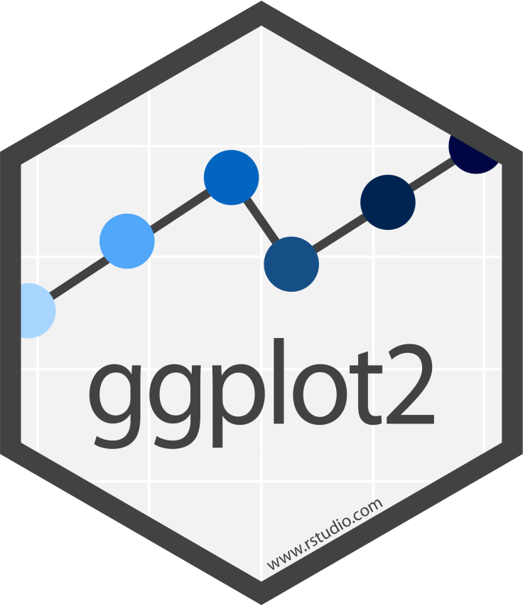
Plotting with ggplot2
ggplot2 provides data visualisation functionality
Works seamlessly with data that follows the tidy data principles
“You provide the data, tell ggplot2 how to map variables to aesthetics, what graphical primitives to use, and it takes care of the details”
Plots are built layer by layer by adding elements
Every detail can be tweaked making plots highly customisable
https://ggplot2.tidyverse.org

Slide 53
Plotting with ggplot2
The following basic template can be adjusted to build a wide variety of graphs:
e.g., ggplot(data = <DATA>,
mapping = aes(<MAPPINGS>)) +
<GEOM_FUNCTION>()
<DATA> is the dataset we want to base our plot on
<MAPPINGS> is where we select the variables to be plotted and specify how they should be presented in the plot i.e., which axis represents each variable, size, shape, colour

Slide 54
Plotting with ggplot2
<GEOM_FUNCTION> specifies the graphical representation we want to employ, e.g.:
geom_point() for scatter plots, dot plots, etc.
geom_bar() and geom_col() for bar charts, etc.
geom_line() for line plots, trend lines, timeseries, etc.
geom_boxplot() for boxplots
geom_violin() for violin plots
geom_step() for step-functions
geom_hline() and geom_vline() for drawing horizontal or vertical lines defined by a y-axis intercept
geom_sf() for spatial data
geom_raster() for raster data

Slide 55
To the geom_bar
Let’s make a basic bar chart of Star Wars species ordered by count:
starwars %>%
mutate(species = fct_lump(species, n = 3,
other_level = "Other"),
species = fct_infreq(species)) %>%
count(species) %>%
drop_na() %>%
ggplot(., aes(x = species, y = n)) +
geom_bar(stat = "identity")

Slide 56
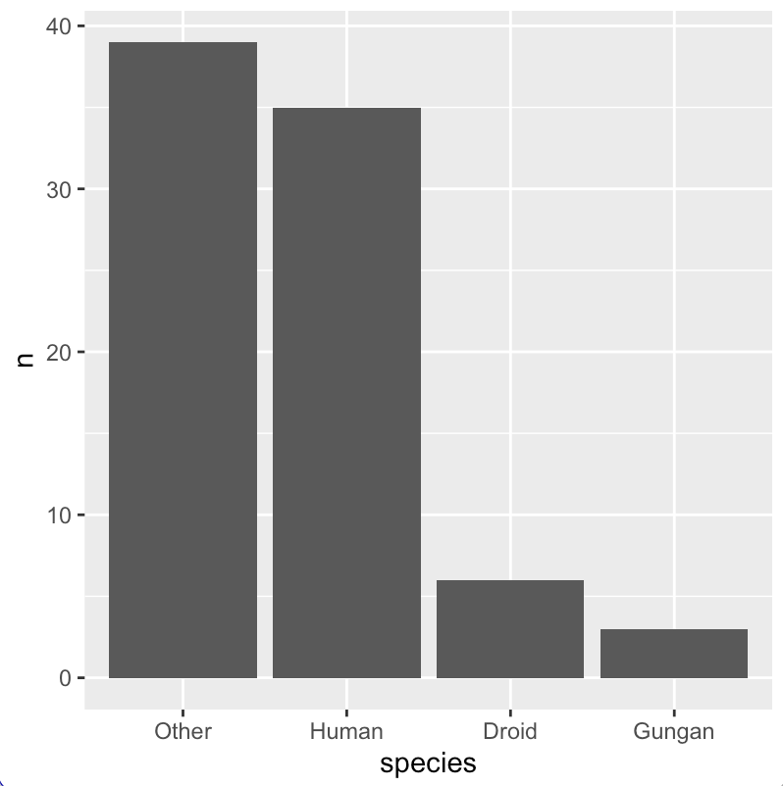
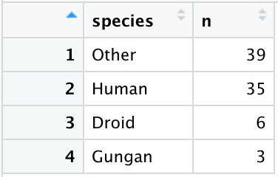
To the geom_bar
We could also do this using geom_col, in which case we would not need to have added stat = "identity" to stop ggplot2 from doing its own aggregation – a default behaviour of geom_bar

Slide 57
Time to geom_step up
Let’s make a basic step plot of the number of Star Wars films over time:
tibble(ReleaseDate = c(1977, 1980, 1983, 1999, 2002,
2005, 2015, 2017, 2019),
Episode = c("IV", "V", "VI", "I", "II", "III",
"VII", "VIII", "IX"),
TotalEpisodes = 1:9) %>%
ggplot(., aes(x = ReleaseDate, y = TotalEpisodes)) +
geom_step()

Slide 58
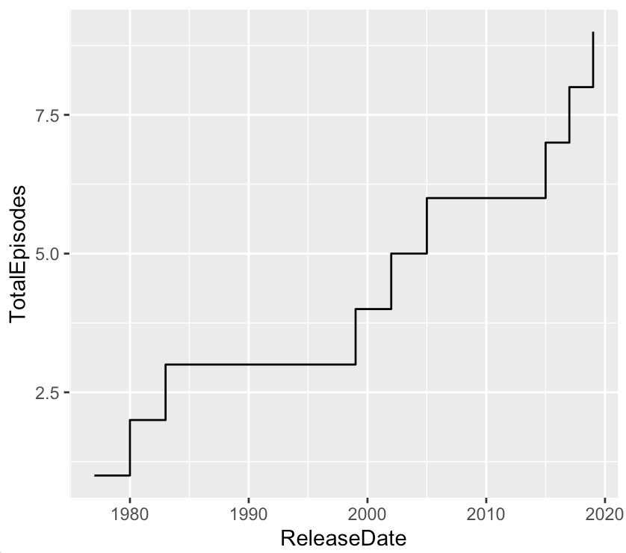
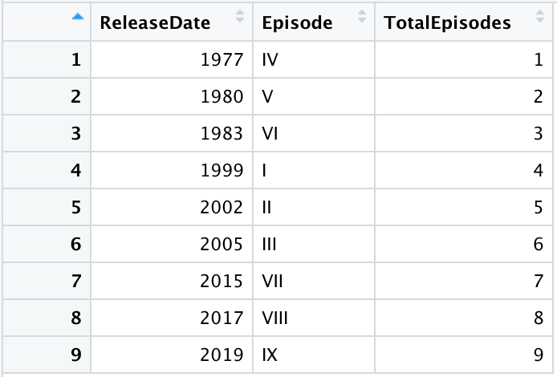
Time to geom_step up

Slide 59
Making a geom_point()
Let’s make a scatter plot to show the relationship between height and mass of Star Wars characters:
starwars %>%
drop_na(mass, height) %>%
ggplot(., aes(x = mass, y = height)) +
geom_point()

Slide 60
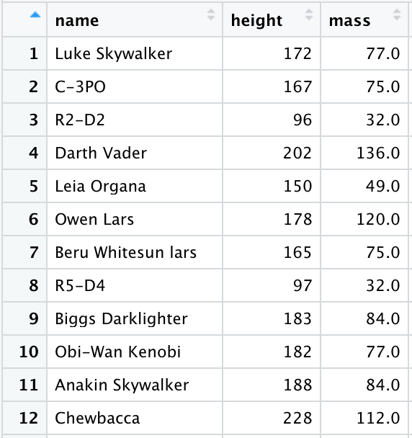
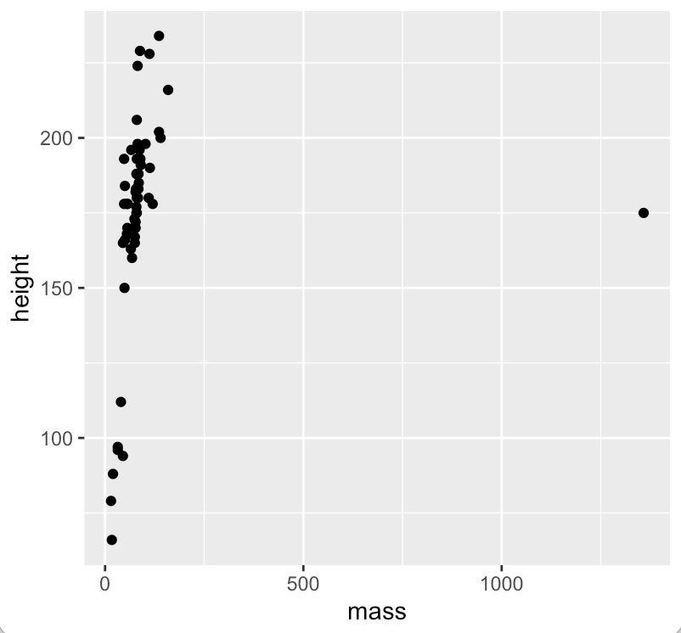
Making a geom_point()

Slide 61
Making a geom_point()
There is a clear outlier
We can remove it for the purpose of plotting without needing to make permanent changes to the data in the tibble
To do so, we will calculate the BMI of each character, then create z-scores based on the BMI values, and remove data points that fall outside of a specified z-score range
All this can be done in a single pipe

Slide 62
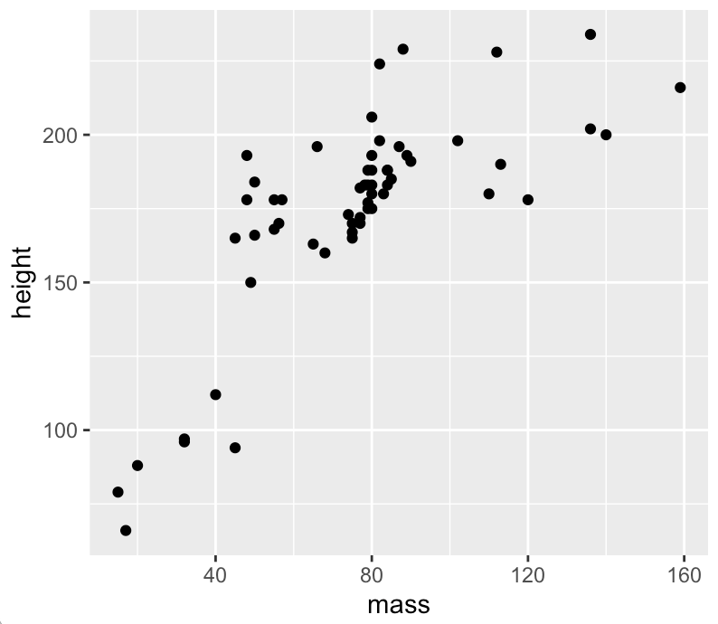
Making a geom_point()
starwars %>%
drop_na(mass, height) %>%
mutate(bmi = mass / (height * 0.01)^2,
zBmi = scale(bmi)) %>%
filter(between(zBmi, -2.5, +2.5)) %>%
ggplot(., aes(x = mass, y = height)) +
geom_point()

Slide 63
Making a geom_point()
What if we wish to distinguish between species in the plot?
We can do so by passing the species categorical variable to the colour and/or shape argument in aes()
starwars %>%
drop_na(mass, height, species) %>%
mutate(species = fct_lump(species, n = 3, other_level = "Other"),
species = fct_infreq(species)) %>%
mutate(bmi = mass / (height * 0.01)^2, .after = mass) %>%
mutate(zBmi = scale(bmi)) %>%
filter(between(zBmi, -2.5, +2.5)) %>%
ggplot(., aes(x = mass, y = height, colour = species)) +
geom_point()

Slide 64
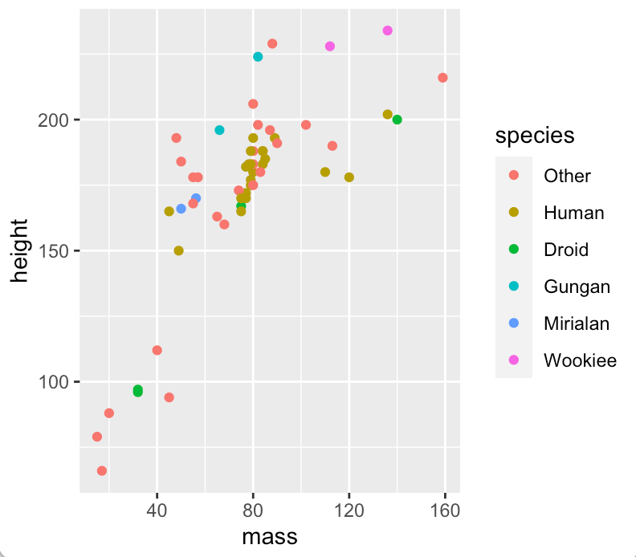
Making a geom_point()

Slide 65
Tweaking data element aesthetics
In addition to colour and shape, it is possible to toy with data element size and alpha values
It is not necessary to pass them to an aes() argument to do so
We could, for example, alter the size, shape, and alpha value of all of the data elements purely out of aesthetic considerations
In the case of the previous plot, we would do this by altering the geom_point arguments

Slide 66
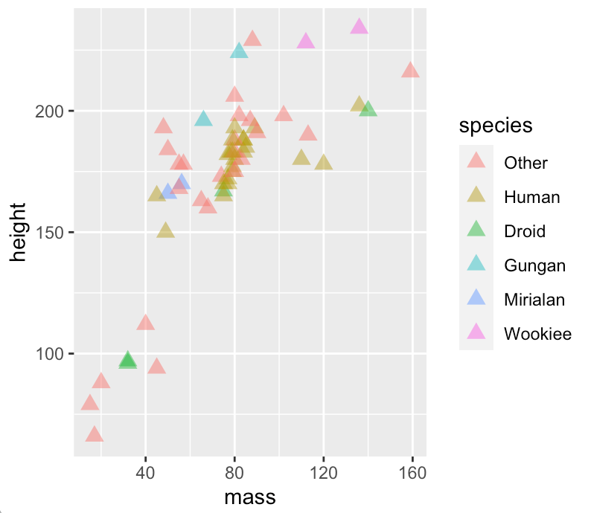
Tweaking data element aesthetics
+ geom_point(alpha = 0.5,
shape = "triangle",
size = 3)

Slide 67
Customise scales
Every plot aesthetic is associated with exactly one scale
It is not necessary to manually specify a scale for each aesthetic – ggplot will create them automatically, taking into account the variable type and aesthetic
However, to override any of the scale defaults, it is necessary to specify the scale yourself

Slide 68
Customise scales
Specify the scale using the name of the aesthetic and the scale type, e.g.:
scale_x_continuous()
scale_y_date()
scale_y_log10()
scale_colour_discrete()
Adding arguments will overwrite the defaults, e.g.:
scale_y_continuous(name = "Count",
breaks = seq(0, 10, 2),
labels = seq(0, 10, 2),
limits = c(0, 25),
expand = c(0,0))

Slide 69
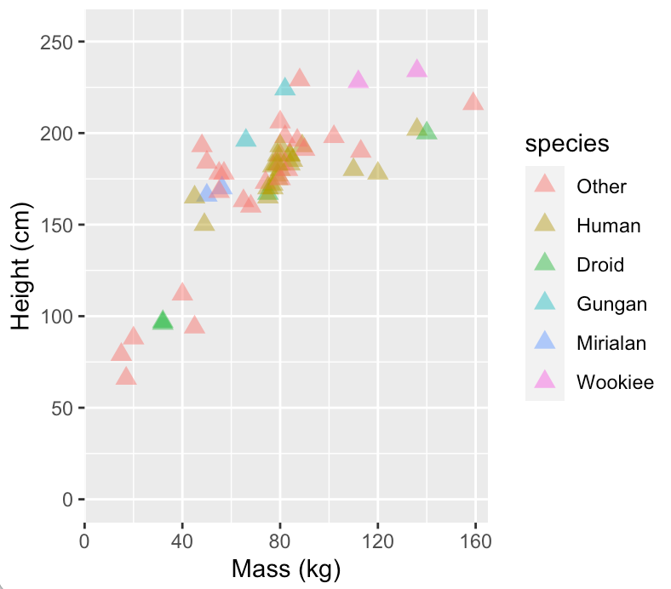
Customise scales
Let’s customise the scales of our scatterplot:
+ scale_x_continuous(name = "Mass (kg)", limits = c(0, 165),
breaks = seq(0, 160, 40), expand = c(0,0)) +
scale_y_continuous(name = "Height (cm)", limits = c(0, 255),
breaks = seq(0, 250, 50))

Slide 70
Customise scale guides
Each scale type has is associated with a default guide type and associated guide function:
Continuous, binned and discrete position scales have an axis: guide_axis()
Non-position discrete scales have a legend: guide_legend()
Continuous colour/fill scales have a colour bar: guide_colourbar()
Binned colour/fill scales have colour steps: guide_coloursteps()

Slide 71
Customise scale guides
The guide functions allow arguments that enable users to tweak text colour, size, font, etc.
However, there are other means of doing this which I prefer – in most cases you will not need to invoke these guide functions

Slide 72
Customise themes
ggplot2’s theme system allows you to adjust the non-data elements of plots (e.g., title, fonts, ticks, axis, grid lines, background, element positioning)
Helps in making plots aesthetically pleasing and consistent with style guides
A number of built-in themes are available, offering pre-sets that reduce the amount of tinkering that is necessary – the default theme is theme_grey()

Slide 73
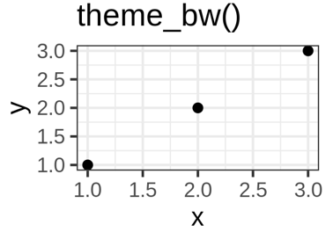
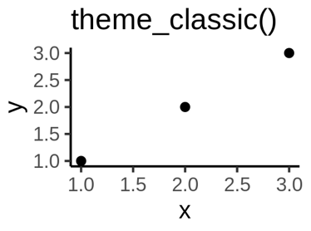
Customise themes
theme_bw()and theme_classic() are particularly good alternative themes to work from when putting together a scientific publication as they are clean and clear
https://ggplot2-book.org/polishing.html

Slide 74
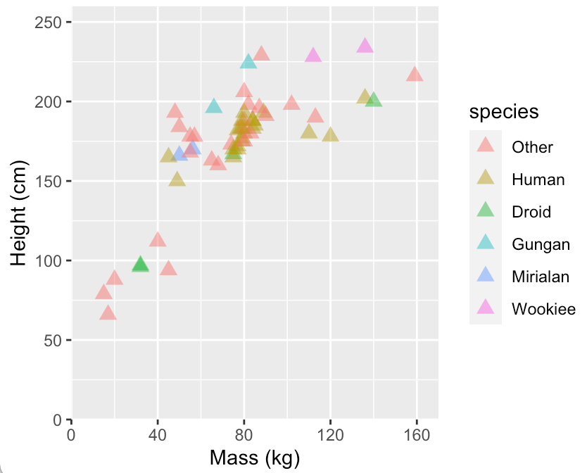
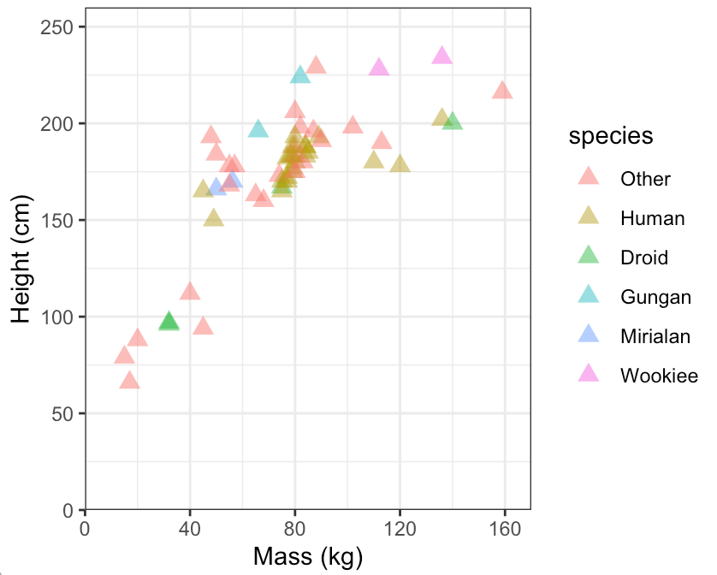
Customise themes
Let’s recreate one of our earlier plots, applying theme_bw()

Slide 75
Customise themes
Let’s customise further using theme()
+ theme(plot.background = element_rect(fill = "#F5F5F5"),
plot.margin = unit(c(.5, .5, .5, .5), "cm"),
panel.grid.minor = element_blank(),
panel.grid.major = element_line(linetype = "dashed",
colour = "black", size = 0.2),
panel.border = element_blank(),
panel.background = element_blank(),
axis.line = element_line(colour = "black"),
axis.text = element_text(face = "italic", colour = "#606060"),
axis.title = element_text(colour = "black"),
legend.title = element_text(face = "italic"),
legend.background = element_blank(),
legend.key = element_blank(),
legend.position = "right")

Slide 76
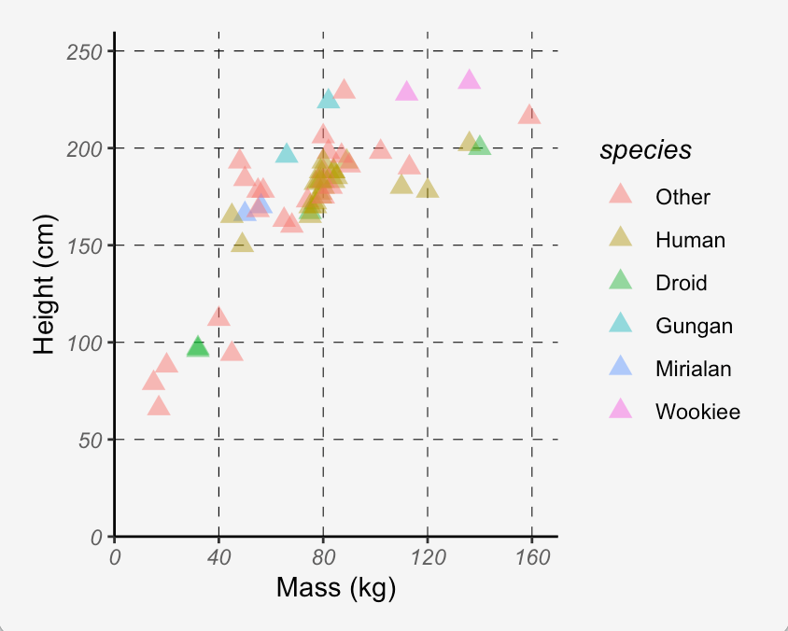
Customise themes

Slide 77
Customise themes
If we plan on styling multiple plots in a similar way, it is wise to convert the theme into a function
Let’s do this for an abbreviated version of the theme we just used:
theme_cleanGrey <- function() {
theme_bw() +
theme(plot.background = element_rect(fill = "#F5F5F5"),
plot.margin = unit(c(.5, .5, .5, .5), "cm"),
panel.grid.minor = element_blank(),
panel.grid.major = element_line(linetype = "dashed",
colour = "black", size = 0.2))
}

Slide 78
Customise themes
Say we saved our custom theme function as a script named theme_cleanGrey.R
We can then access it from other scripts using source("filepath/theme_cleanGrey.R")
We can then simply substitute the theme in our earlier script for theme_cleanGrey()

Slide 79
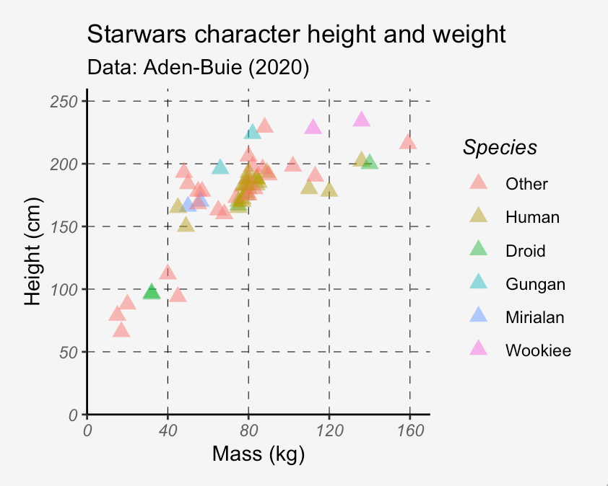
Plot and legend titles
Plot and legend titles can be added as follows:
+ scale_colour_discrete("Species") +
ggtitle(label = "Starwars character height and weight",
subtitle = "Data: Aden-Buie (2020)")

Slide 80
Working with & visualising spatial
data using sf & ggplot2

Slide 81
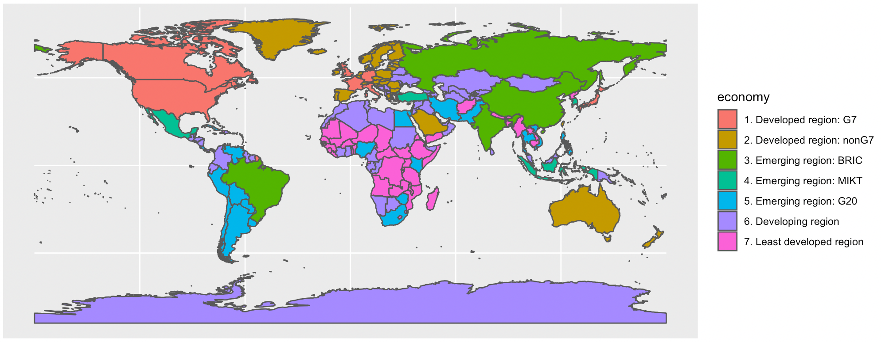
Visualising spatial data
We can plot spatial data, such as points, lines and polygons with ggplot2 using geom_sf()
countries <- ne_countries(scale = "medium", returnclass = "sf")
ggplot() +
geom_sf(data = countries, aes(fill = economy))
+

Slide 82
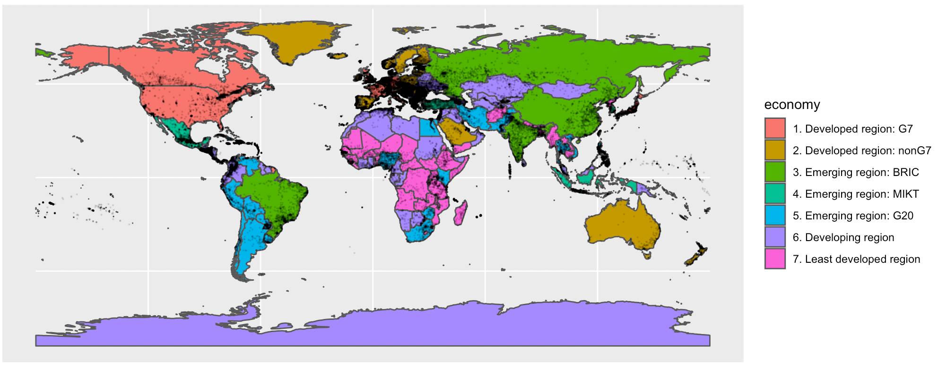
Visualising spatial data
Let’s add an additional layer showing the location of cities
cities <- st_as_sf(world.cities, coords=c("long", "lat"), crs = 4326) ggplot() +
geom_sf(data = countries, aes(fill = economy)) +
geom_sf(data = cities, alpha = 0.1, size = 0.1)
+

Slide 83
Reprojecting spatial data
For sf objects, the existing Coordinate Reference System (CRS) of an object can be viewed using st_crs()
Often, we need to change the coordinates of our spatial object into a new CRS
We can reproject are data using st_transform()
It requires us to specify the object to be reprojected and the desired CRS
+

Slide 84
Reprojecting spatial data
WGS84 (EPSG:4326) is commonly used
GPS datasets and many raster and vector datasets are provided in this CRS by default, and it is used extensively in web mapping
But we may want to use a more location appropriate CRS or a projection that offers more accurate proportions in area
+
https://geocompr.robinlovelace.net/reproj-geo-data.html

Slide 85
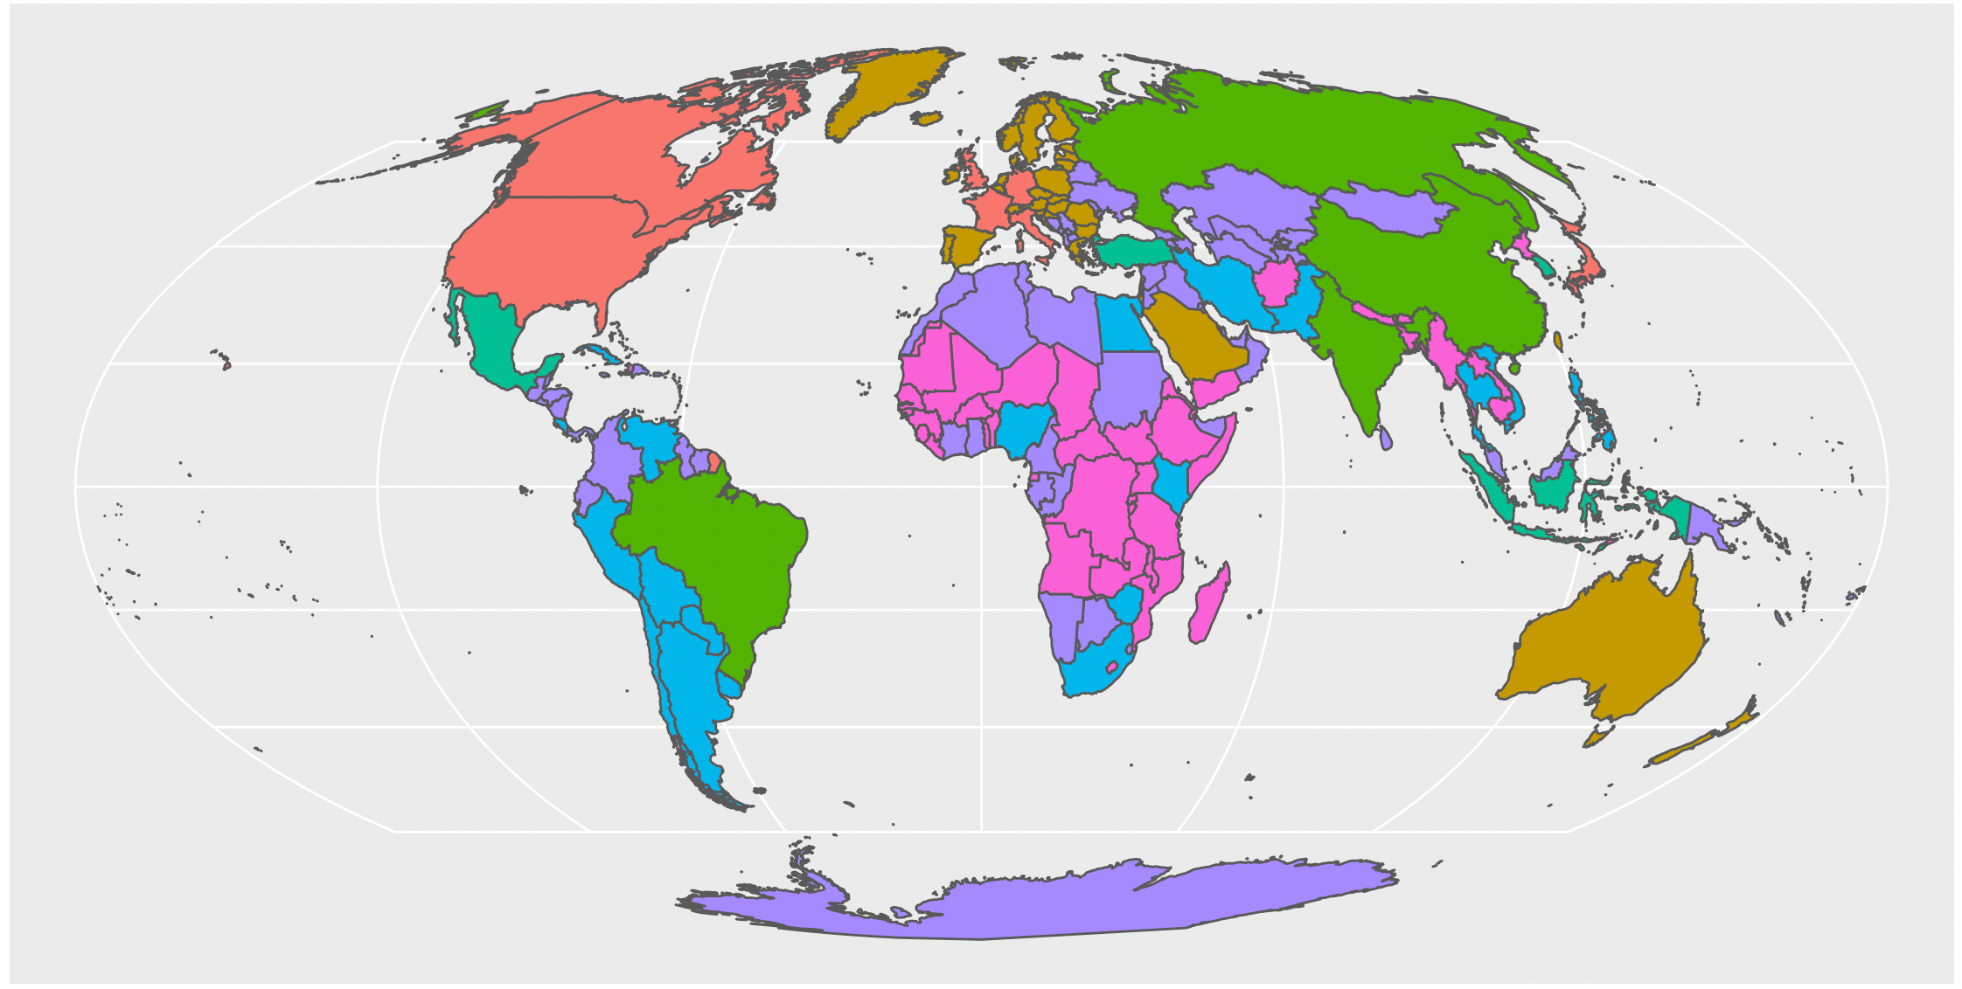
Reprojecting spatial data
For example, we could plot our world map using the Mollweide projection
st_transform(countries, crs = "+proj=moll") %>%
ggplot(.) +
geom_sf(aes(fill = economy))
+

Slide 86
Reprojecting spatial data
Tools to help in selecting a suitable CRS include the crssuggest package
It’s suggest_crs() function takes a spatial object with geographic CRS and returns a list of possible projected CRSs that could be used for the given area
+

Slide 87
Simplifying spatial data
We can use ms_simplify() from the rmapshaper package to remove relatively extraneous vertices from polygons while preserving their essential shape to improve legibility, reduce object size, and speed up plotting
+

Slide 88
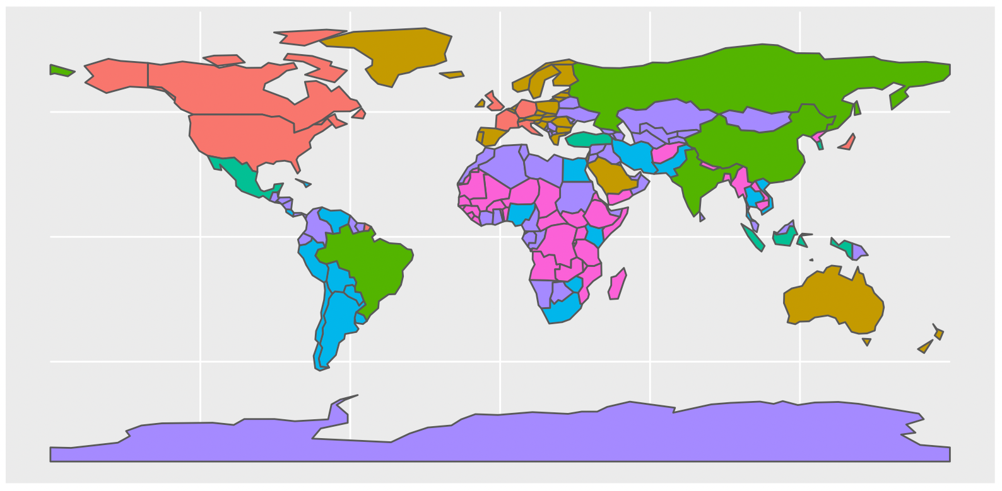
Simplifying spatial data
library(rmapshaper)
countries <- ms_simplify(countries, keep = 0.01)
ggplot() +
geom_sf(data = countries, aes(fill = economy))
+

